Slide 1
Australian Fatal Road Accident Analysis
Phimnarin Aksupak
Monash University Data Analytics Boot Camp

Slide 2
Background
The Australian Road Deaths Database provides basic details of road transport crash fatalities in Australia
the factors that cause more accidents.
Datasets
Kaggle, Australian Fatal Road Accident 1989-2021
https://www.kaggle.com/deepcontractor/australian-fatal-car-accident-data-19892021/version/2

Slide 3
Research Questions
Does the age of the driver affect the accident?
Does the gender of the driver affect the accident?
Compare the accidents that occurred in each state.
Accidents happen more during the day or at night?
Do more accidents happen during Christmas?
Do more accidents happen during Easter?

Slide 4
Hypothesis
The alternative hypothesis (Ha) is that there is a significant correlation between age of the driver and accident on the road.
The null hypothesis (H0) is that there is not a significant correlation between age of the driver and accident on the road.
The data from the linear graph (Number of accidents occurring in each age range in Australian Fatal Road Accident 2018-2021) shows the trend of accidents compared to the age of the driver. Newly licensed drivers are at the highest risk of causing accidents. The older the driver significantly shows the reduction of the accident rates. Therefore, age and the amount of incidence were significantly related.

Slide 5
Data Exploration
Data cleaning, formatting and analysis by Pandas and jupyter notebook
Create graphs and bar charts by Matplotlib

Slide 6
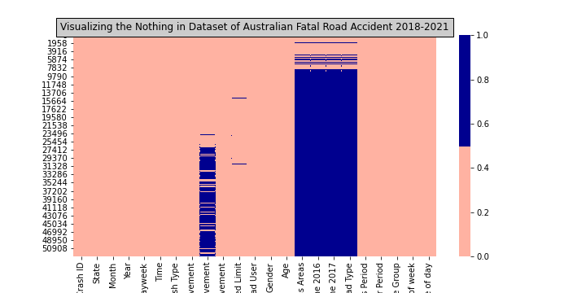
Graph Visualizing the Nothing in Dataset

Slide 7
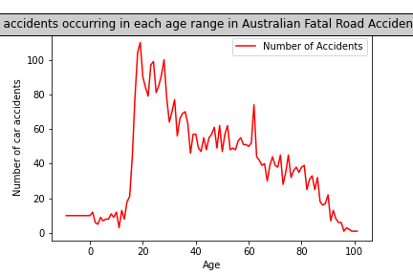
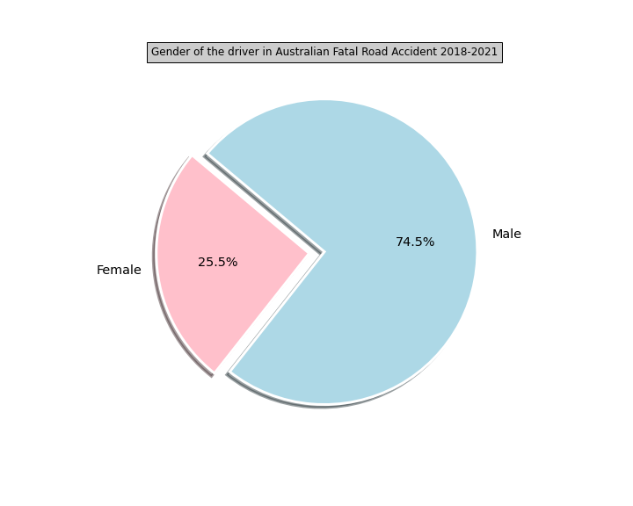
Graph

Slide 8
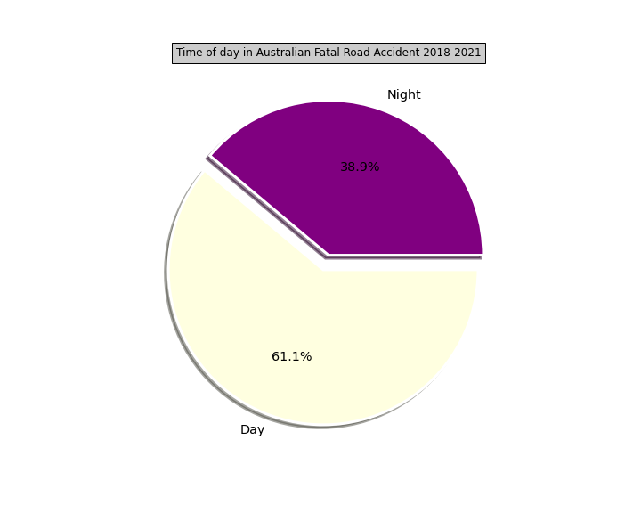
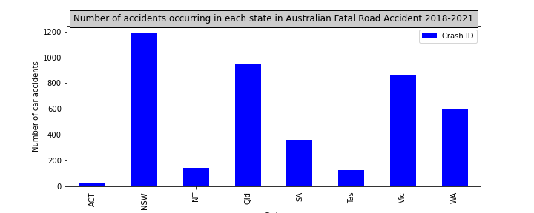
Graph

Slide 9
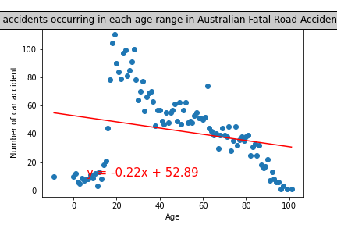
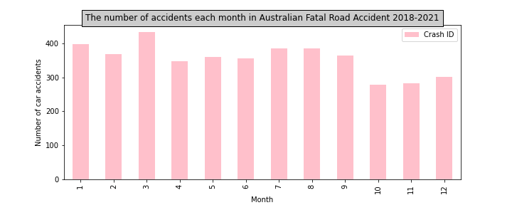
Graph

Slide 10
The End
Thank you

